Slide 1

Secure and Robust Ultrasonic sensors for Autonomous Vehicles
Automotive Sensor System SS21
Mayur Tulsibhai Lakhani
(485315)
Technische Universität Chemnitz
Master in Automotive Software Engineering

Slide 2
Outline
Motivation & Introduction
State-of-the-art of Ultrasonic sensors
Working principle of Ultrasonic Sensor
Different types of attacks & Defense Methodology
PSA functionality, implementation & Experiment results
Conclusion

Slide 3
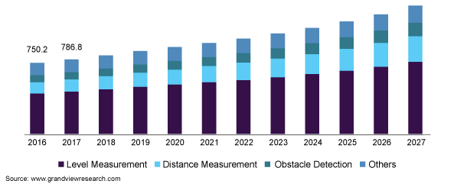
Motivation
Automotive Functional Domain
Passenger centric
Auto parking (Body/Comfort)
Compound Annual
Growth Rate 6 %
Vehicle centric [Safety]
Reliability
Should be highly secure
Robust to any type of spoofing & jamming attacks
Lane changing during Autopilot mode (Safety & Cross Domain)
U.S. ultrasonic sensor market size, by type, 2016 - 2027 (USD Million) [8]
(more critical)

Slide 4
Introduction
Situation | Decision under Attack | Attacks
W/O obstacles (Create imaginary) | Stop moving | Random spoofing Adaptive spoofing
W/ obstacles (Hide) | Keep moving | Jamming Adaptive spoofing
The feasibility of Ultrasonic sensor under attacks with moving vehicles[3]
Ultrasonic sensor’s Operational Frequency(f):
In between 40kHz to 50kHz
f > 50 kHz → attenuation of airborne → Result: weak echoes
f < 40 kHz → interfering sound

Slide 5
State-of-the-art: Ultrasonic sensors under attacks
Ultrasonic Frequency Range [3]
 |  | Output under attacks (Spoofing) |  |  | Specifications
Sensor | Freq. | Random | Adaptive | Jamming | Volt. | Measuring Distance | Accuracy | Measuring (Degree)
SRF05 | 40 kHz | Steady | Steady | Min | +5V DC | 2-450cm | 3mm | 15
HC-SRO4 | 40 kHz | Steady | Steady | Min | +5V DC | 2-450cm | 3mm | 15
JSN-SRO4T | 40 kHz | Steady | Steady | Min | +5V DC | 2-450cm | 2mm | 75
US-100 | 40 kHz | Steady | Steady | Min | +5V DC | 2-450cm | 1mm | 30
URM37 | 40 kHz | Steady | Steady | Min | +3.3 -0.5V | 5-500cm | 10mm | 0-180 (Servo)
RCW-0001 | 40 kHz | Steady | Steady | Min | +3 -5.5V | 2-450cm | 10mm | 15
URM04 | 40 kHz | Unsteady | Steady | Min | +5V | 4-500cm | 10mm | 0-180
Grove U. R. | 42 kHz | Steady | Steady | Min | +3.2 -5.2V | 3-350cm | 10mm | 15
SRF01 | 42 kHz | Unsteady | Steady | Min | +3.3-12V | 18-600cm | 10mm
MB1200 | 42 kHz | Unsteady | Steady | Max | +3.3-5V | 0-765cm | 10mm
Audi Q3 | 50 kHz | Unsteady | Steady | Max

Slide 6
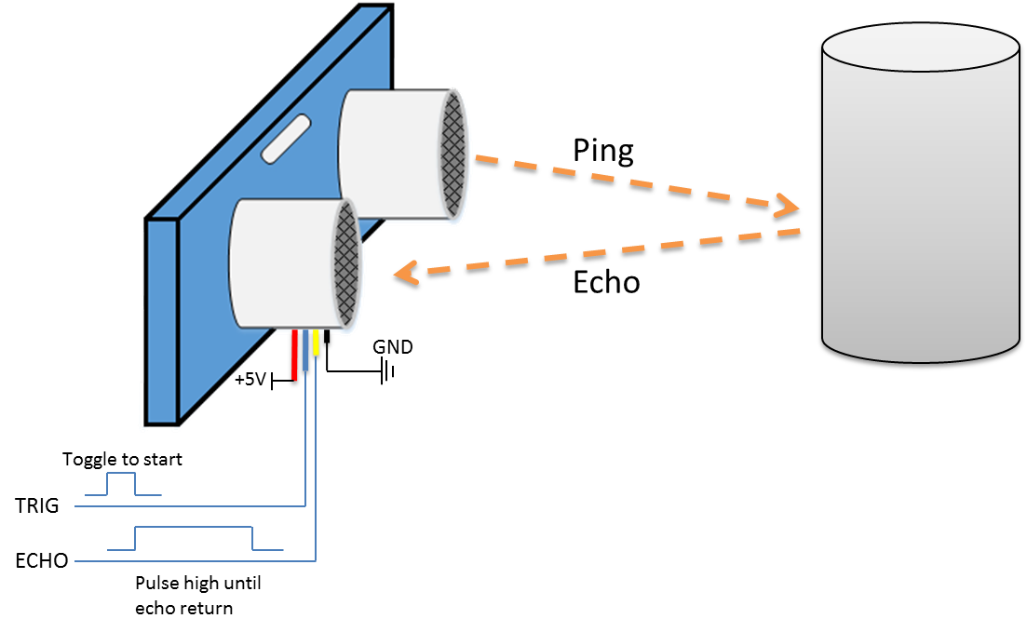
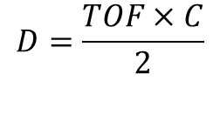
Working principle of Ultrasonic sensor
HC - SR04 Module
Emitter
Detector
Obstacle
Measure the distance by ultrasonic sensor[9]
$$D=\frac{TOF×C}{2}$$
Where,
TOF: Time of flight
C: Speed of sound waves
D: Distance between sensor and object
Measuring distance from 2cm to 400cm
Operational Frequency Range: 30KHz - 180KHz

Slide 7
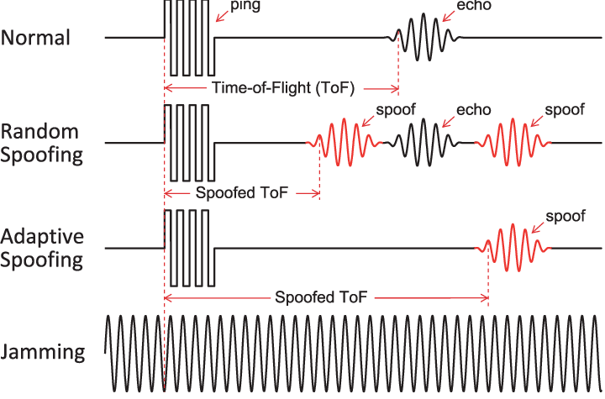
Ultrasonic sensors under different types of attacks
[3]
Random Spoofing: Replay previously recorded sensor signals to deceive the sensor
Adaptive Spoofing: Creating non existing obstacles
Step1: receiving sensor signals
Step2: eliminating echoes
Step3: transmitting spoof signals
Jamming attacks: Emits high ultrasonic sounds to overwhelm echoes.

Slide 8




Defense Enhancement Strategies
Overview of the Defense Scheme Functions[3]
1. PSA | Attacks | Attack Detection |  | Resilient obstacle Detection |  | Attacker Localization
Physical Shift Authentication(PSA) Vs. Multiple Sensor Consistency Check (MSCC) | Random Spoofing
 | Adaptive Spoofing
 | Jamming
2.MSCC
1 2
1 2
1 2

Slide 9
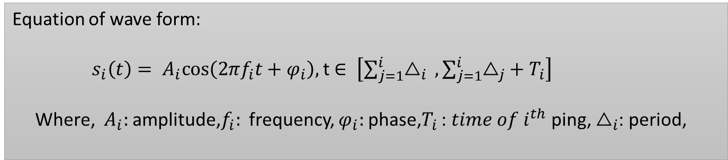
Physical shift Authentication functionality
Customize the ping waveform through randomize certain parameters to corelate the received echo with the ping
Randomize the ping waveform (X). Transmit
Receive, and Measure the echo waveform (Y), where Y = f(X)
if C( x, y ) > α (threshold) , accept the echo else reject, where C is Correlation
Equation of wave form:
$s_{i}\left(t\right)= A_{i}cos\left(2πf_{i}t+φ_{i}\right),$t $∈ \left[\sum_{j=1}^{i}{△_{i}} ,\sum_{j=1}^{i}{△_{j}+{ T}_{i}}\right]$
Where, $A_{i}:$ amplitude,$f_{i}:$ frequency, $φ_{i}:$phase,$T_{i}$ : ${time of i}^{th}$ ping, $△_{i}$: period,

Slide 10
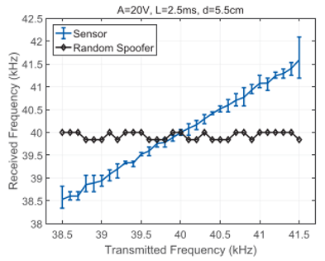
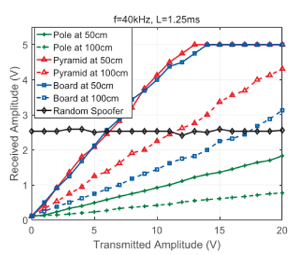
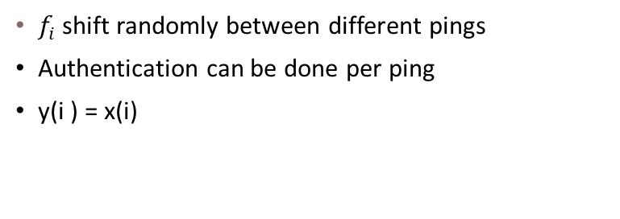
PSA implementation along with Experiment results
[3]
[3]
Frequency shift:
Amplitude shift:
0.212kHz
Detection Range
$f_{i}$shift randomly between different pings
Authentication can be done per ping
y(i ) = x(i)
Received Amp.( ) with Transmitted Amp.
Obstacles → Distances → Attenuation
Amplitude attenuation → linearity ➔ Valid echoes

Slide 11
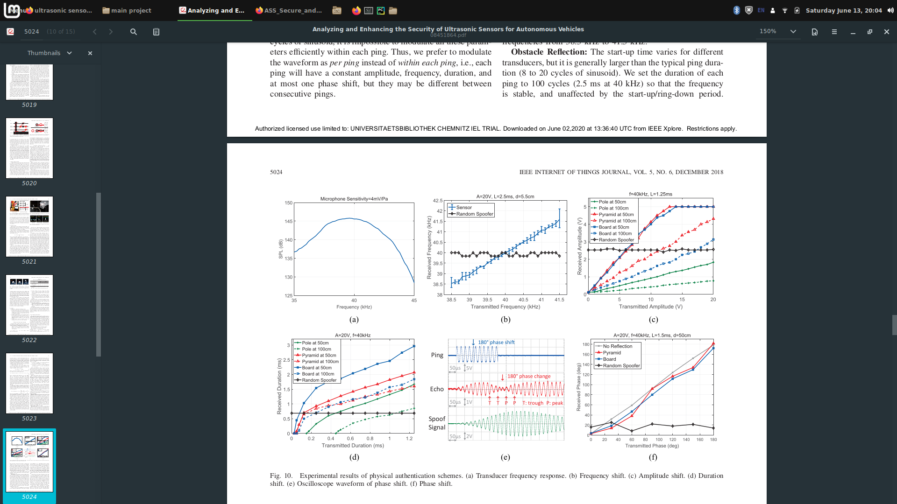
PSA implementation along with Experiment results
[3]
[3]
Duration Shift:
Phase Shift:
More than 20 cycles (0.5ms at 40kHz)
Duration of received echoes are approximately liner to those of the corresponding pings.
Y(i) = f(x(i)) = λx(i) + υ; where λ and υ are
constants for a certain obstacle
When the force is shifted to a reverse direction, the membrane gradually decreases the amplitude and then increases following the new phase

Slide 12
Conclusion
Experiments validate that shifting frequency, amplitude, duration, phase, and period can be used for distinguishing spoofed echoes that does not change in accordance with the modulated pings.
Under the same time efficiency, the performance ranks as:
Frequency Shift > Phase Shift > Amplitude Shift > Duration Shift
Successful detection rate with three cycles of frequency shift is 99.8% and can be increased with wider transducer frequency range
Effective range of the attacks relies on both the operational range of sensors and the transmission power of the attack equipment, which can be improved with budgets.

Slide 13
References
U. Khalil, A. Nasir, S. M. Khan, T. Javid, S. A. Raza and A. Siddiqui, "Automatic Road Accident Detection Using Ultrasonic Sensor," 2018 IEEE 21st International Multi-Topic Conference (INMIC), Karachi, 2018, pp. 206-212, doi: 10.1109/INMIC.2018.8595541.
B. S. Lim, S. L. Keoh and V. L. L. Thing, "Autonomous vehicle ultrasonic sensor vulnerability and impact assessment," 2018 IEEE 4th World Forum on Internet of Things (WF-IoT), Singapore, 2018, pp. 231-236, doi: 10.1109/WF-IoT.2018.8355132.
W. Xu, C. Yan, W. Jia, X. Ji and J. Liu, "Analyzing and Enhancing the Security of Ultrasonic Sensors for Autonomous Vehicles," in IEEE Internet of Things Journal, vol. 5, no. 6, pp. 5015-5029, Dec. 2018, doi: 10.1109/JIOT.2018.2867917.
Tesla. Model S Software Release Notes V7.1. [Online – Accessed on 14.05.2021]. Available: https://www.tesla.com/sites/default/files/pdfs/release_notes/tesla_model_s_software_7_1.pdf
Tesla. Enhanced Autopilot. [Online - Accessed on 14.05.2021 ]. Available: https://www.tesla.com/de_DE/autopilot
U. Khalil, A. Nasir, S. M. Khan, T. Javid, S. A. Raza and A. Siddiqui, "Automatic Road Accident Detection Using Ultrasonic Sensor," 2018 IEEE 21st International Multi-Topic Conference (INMIC), Karachi, 2018, pp. 206-212, doi: 10.1109/INMIC.2018.8595541.

Slide 14
References
Marketresearchfuture. “Global Automotive Ultrasonic Sensors Market Research Report”. [Online – Accessed on 28.05.2021]. Available: https://www.marketresearchfuture.com/reports/automotive-ultrasonic-sensors-market-10359
Grandviewresearch. “Ultrasonic Sensors Market Size, Share & Trends Analysis Report By Technology”. [Online – Accessed on 28.05.2021]. Available: https://www.grandviewresearch.com/industry-analysis/ultrasound-sensors-market
Amebaiot. “[RTL8195AM] [RTL8710AF] GPIO - Measure the distance by ultrasonic module”. [Online – Accessed on 14.05.2021]. Available: https://www.amebaiot.com/en/ameba-arduino-gpio-ultrasonic/
Vipul Kushwaha , Sachin Bojewar. “A Survey of Ultrasonic Sensors and their Applications ”, 2019 IJACCE, India, Vol. 8, Issue 11, November 2019, ISSN(Online) 2278-1021. doi: 10.17148/IJARCCE.2019.81120.
Datasheetpdf. “HY-SRF05 Precision Ultrasonic Sensor”. [Online - Accessed on 03.06.2021 ]. Available: https://datasheetspdf.com/pdf-file/813041/ETC/HY-SRF05/1
Dfrobot. “URM37 Ultrasonic Sensor (2～800cm)”. [Online - Accessed on 03.06.2021 ]. Available: https://www.dfrobot.com/product-53.html
Cytron. ”RCW-001 Micro Ultrasonic Range”. [Online - Accessed on 03.06.2021 ] . Available: https://www.cytron.io/p-rcw-0001-micro-ultrasonic-range

Slide 15
References
Dfrobot. “URM04 Ultrasonic Sensor”. [Online - Accessed on 03.06.2021 ] . Available: https://www.dfrobot.com/product-101.html
Cdn-reichelt. “Grove - Ultrasonic Ranger ”. [Online - Accessed on 03.06.2021 ] . Available: https://cdn-reichelt.de/documents/datenblatt/A300/101020010_01.pdf

Slide 16
Thank You!

Slide 17
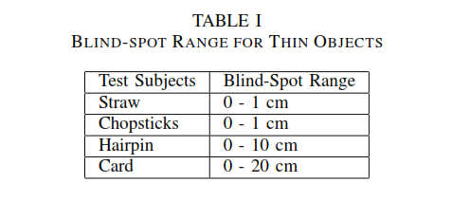
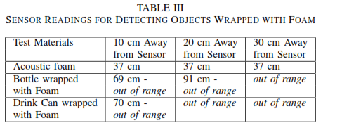
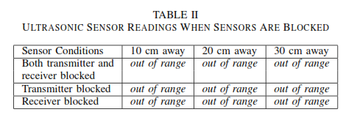
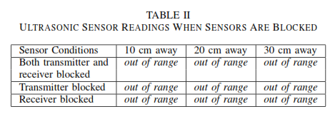
HC SR04 - Test Cases [2]
3. Acoustic Foam (r =35cm extended)
1. Thine Object as an obstacle (r=30cm)
2. Covering Transmitter & Reciver( cardboard)
4. Interference with Additional Sensors

